Slide 1


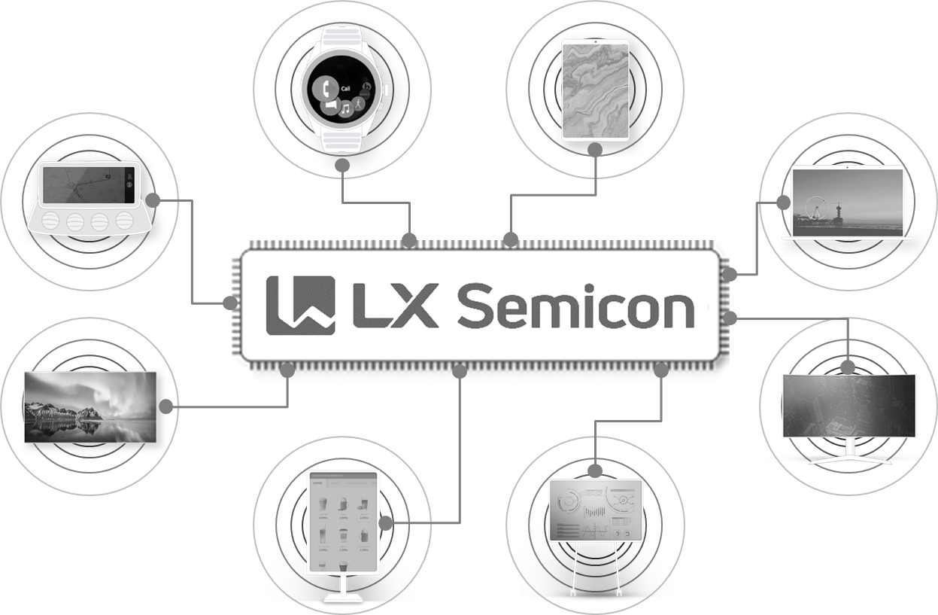

AIT Touch Overview
LX Semicon has been growing as a leading total solution provider of Touch Controller and is now heading to be the global top tier fabless company with its cutting edge design and development competitiveness.
Jun, 22. 2021
LX Semicon Co., Ltd.

Slide 2


AIT Touch Overview
AIT System

Slide 3








AIT Touch Overview
AIT System
Frame#1
16.667ms ( 60Hz )
Frame#2
16.667ms ( 60Hz )
VSYNC
TSYNC | Display1 |  |  | Touch1 | Display2 | Touch2 | Display3 | Touch3 | Display4 | Touch4 | Display1 |  |  | Touch1 | Display2 | Touch2 | Display3 | Touch3 | Display4 | Touch4
Touch | 1LHB |  |  |  | 2LHB |  | 3LHB |  | 4LHB |  | 1LHB |  |  |  | 2LHB |  | 3LHB |  | 4LHB
Pen Mode | D1 |  |  | T1 | D2 | T2 | D3 | T3 | D4 | D4 | D1 |  |  | T1 | D2 | T2 | D3 | T3 | D4 | D4
Display
Touch
Algorithm
Touch 좌표
Touch 좌표
( X, Y )
< Display >
< Touch >

Slide 4
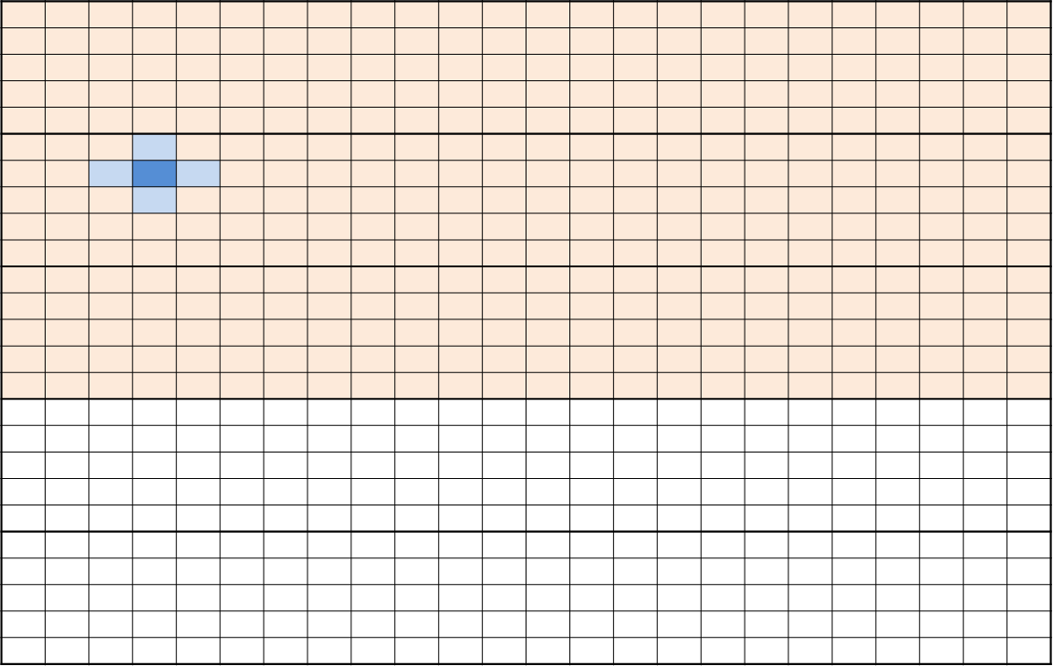
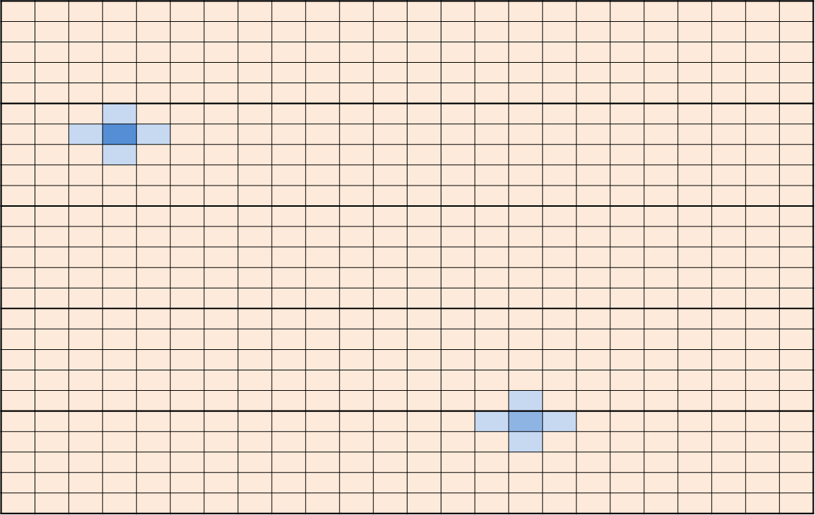

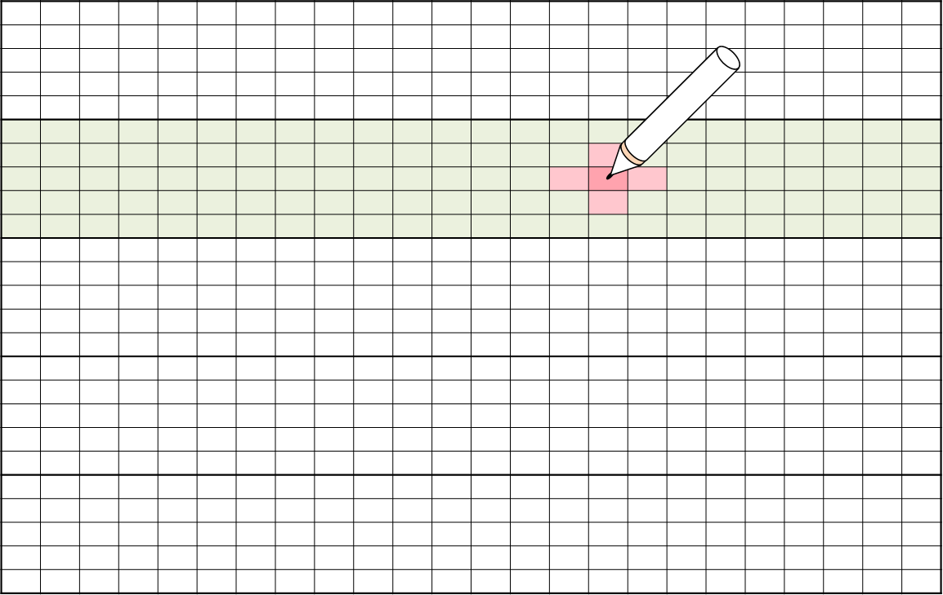
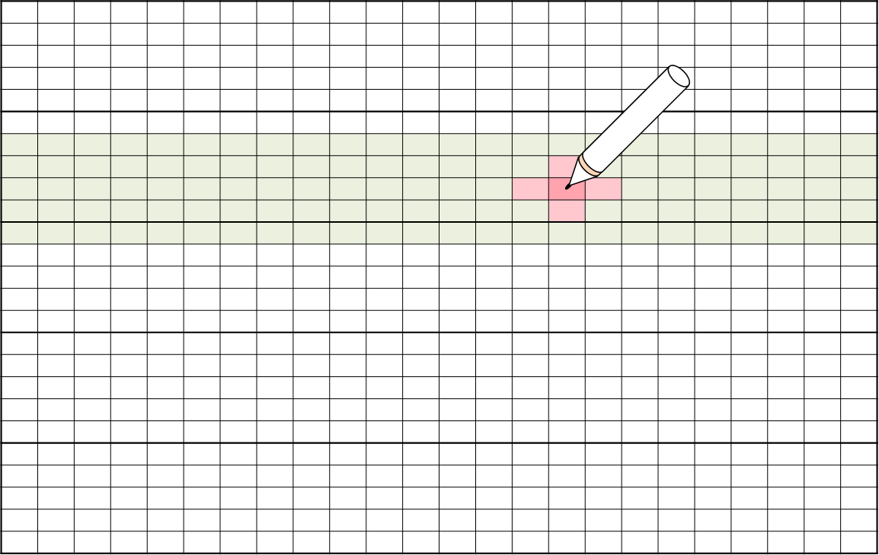
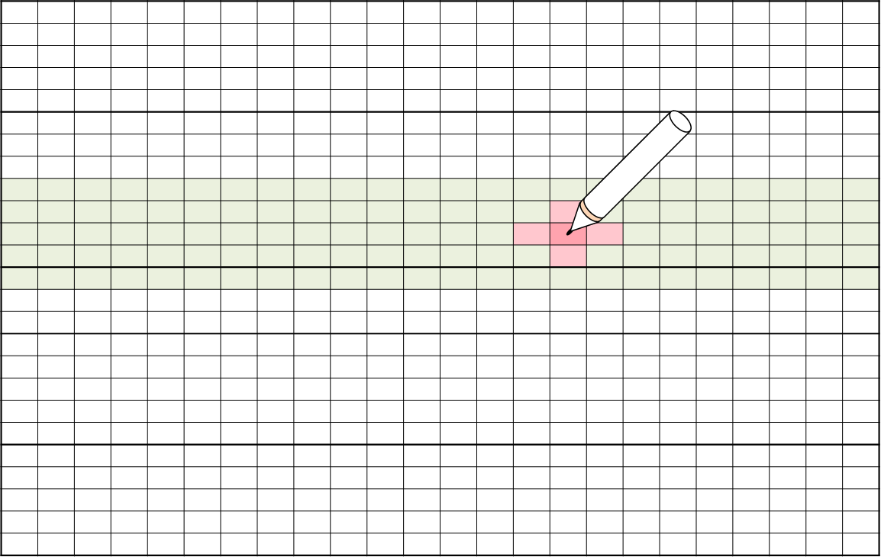
AIT Touch Overview
Active Pen System
Pen 및 Finger를 구분하여 Sensing하기 위해 LHB 구조를 사용 ( 8LHB / 16LHB 등 )
Display를 분할하여 출력하는 사이에 Touch Data를 Sensing
Display 1~8 : Display 1-Frame ( 60Hz ) / Touch 1~8 : Pen/Finger Data
D : Display / B : Beacon / F : Finger / PP : Pen Position / PD : Pen data / T : Tilt
16.667ms ( 60Hz )
TSYNC | Display1 | Touch1 | Display2 | Touch2 | Display3 | Touch3 | Display4 | Touch4 | Display5 | Touch5 | Display6 | Touch6 | Display7 | Touch7 | Display8 | Touch8
Touch | 1LHB |  | 2LHB |  | 3LHB |  | 4LHB |  | 5LHB |  | 6LHB |  | 7LHB |  | 8LHB
Pen Mode | D | B | D | PD1 | D | T | D | PD2 | D | F1 | D | PD3 | D | F2 | D | PD4
Sensing
Pen 처리
Finger 처리
Pen좌표
Pen좌표
Pen좌표
Pen좌표
Figner좌표
( Fx1, Fy1 )
( Px, Py )
( Px’, Py’ )
( Px’’, Py’’ )
( Fx2, Fy2 )

Slide 5



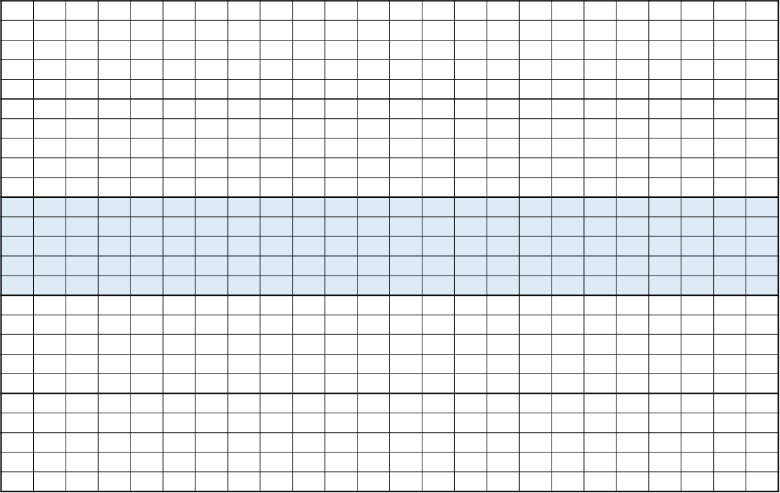


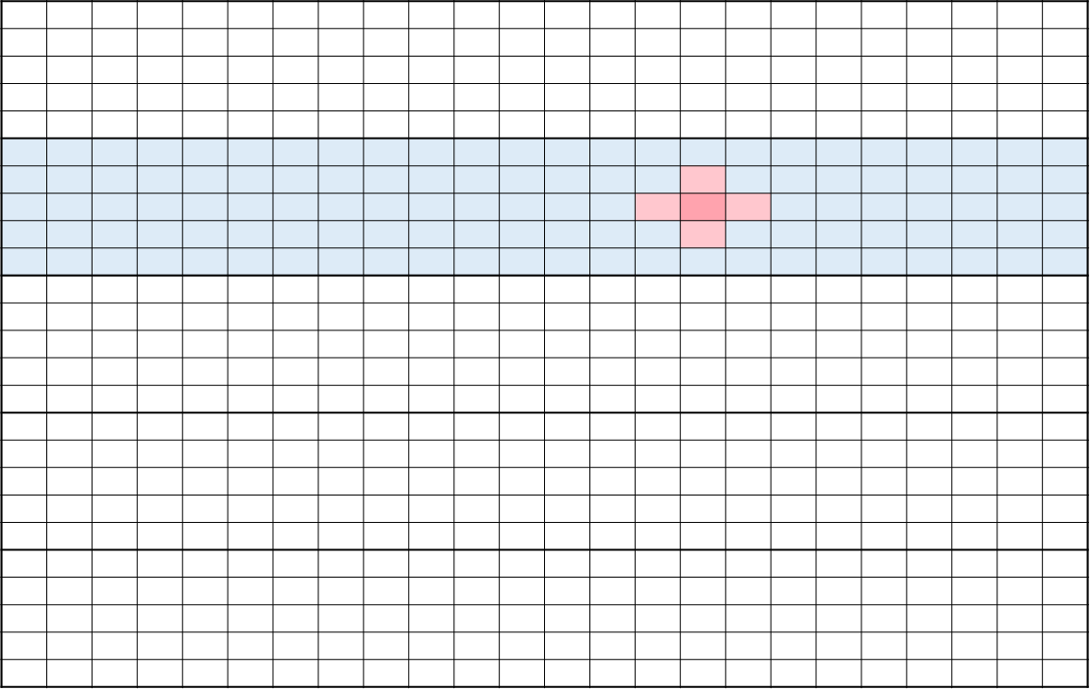
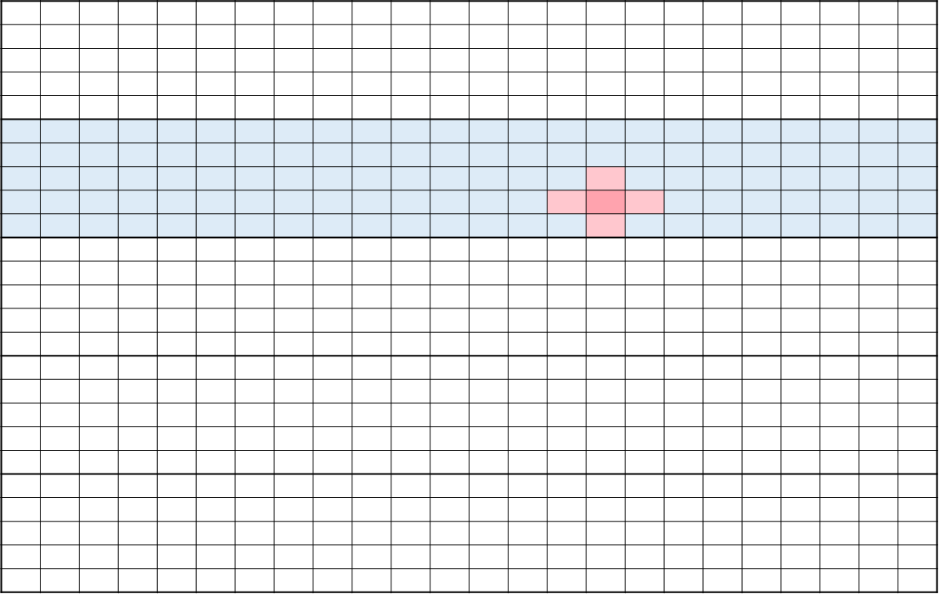
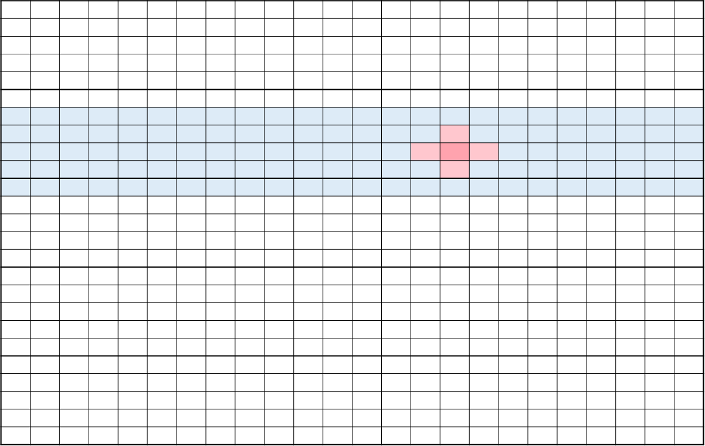
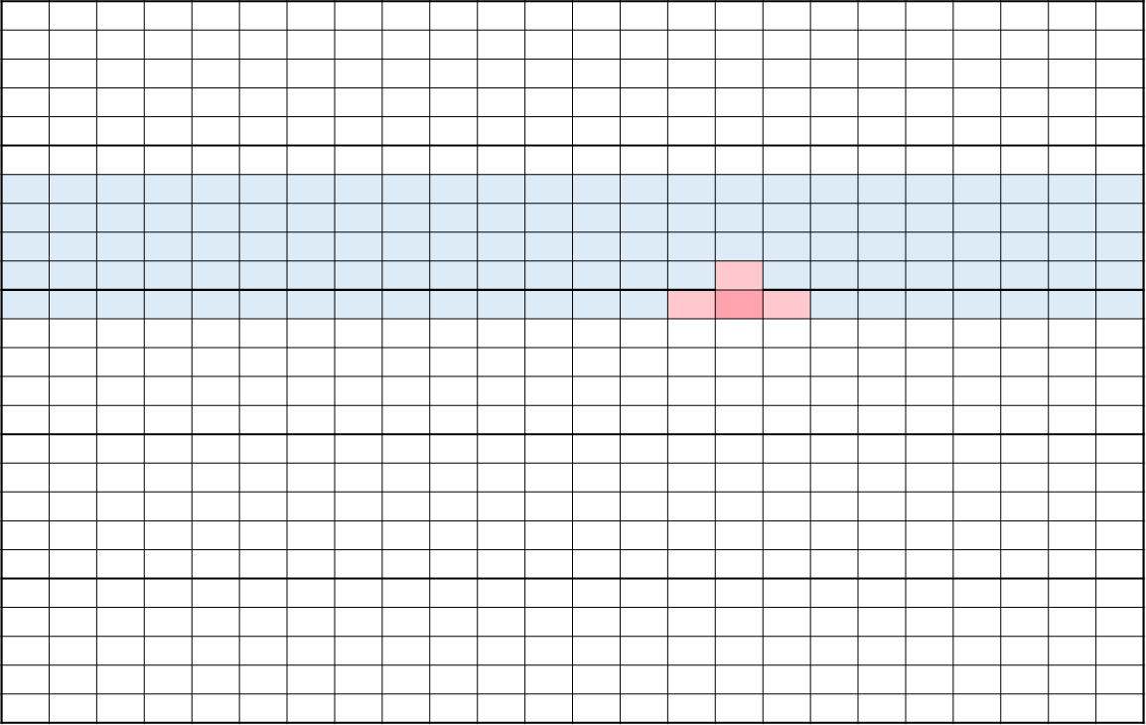
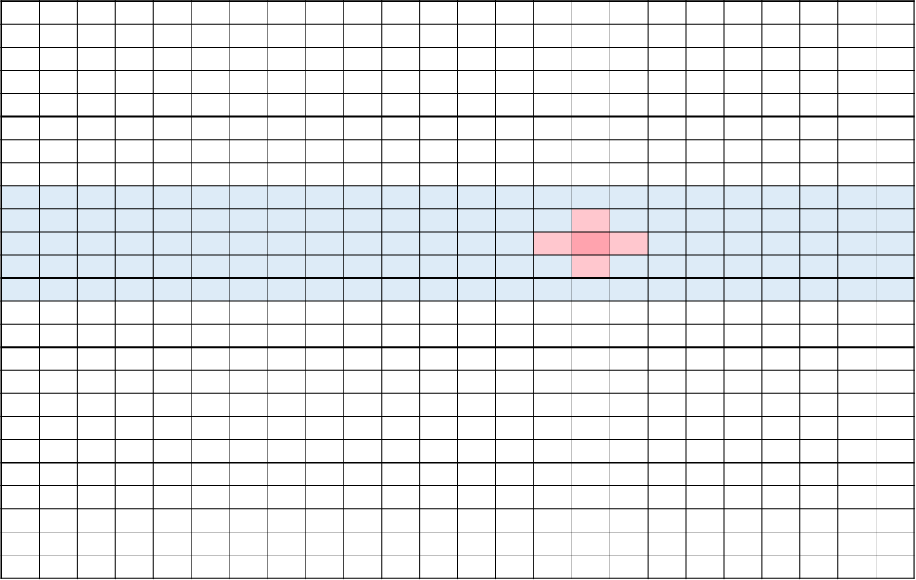
AIT Touch Overview
Pen Detection Sequence
1-Pen만 지원하므로 1Mux Data로 Algorithm 처리가 가능
Sensing 영역을 순차적으로 변경하다가 Pen이 발견되면 해당 위치를 유지
Pen이 움직이는 경우, Sensing 영역의 중심에 Pen이 위치하도록 Sensing 영역을 변경 ( Tip / Ring간에도 영역을 구분 )

Slide 6
Active Pen Overview
Sensor
Beacon

Slide 7
Active Pen Overview
LHB Type #1 : Beacon
Beacon

Slide 8
Active Pen Overview
LHB Type #2 : Finger
Beacoob

Slide 9
Active Pen Overview
LHB Type #3 : Pen Position
Beacoob

Slide 10
Active Pen Overview
LHB Type #4 : Pen Data
Beacoob

